Slide 1
“cunningly devised fables”
Notes:
During the latter days of the apostles a whistle blower appeared amongst the churches who secretly creeped in unnoticed at first and began blowing his whistle, saying that Peter and the other apostles were teaching “cunningly devised fable, stories that they cleverly invented, concerning the coming and return of the Lord Jesus Christ in power and glory.

Slide 2
“deceptive words”
Notes:
But Peter, the real whistle blower, is ahead of these fake whistle blowers warning the church in advance of the many bold and arrogant false teachers who are coming with “deceptive words” “stories they have made up” [NIV], introducing secretly, destructive heresies, bringing destruction and judgment upon themselves and those who foolishly follow them.

Slide 3
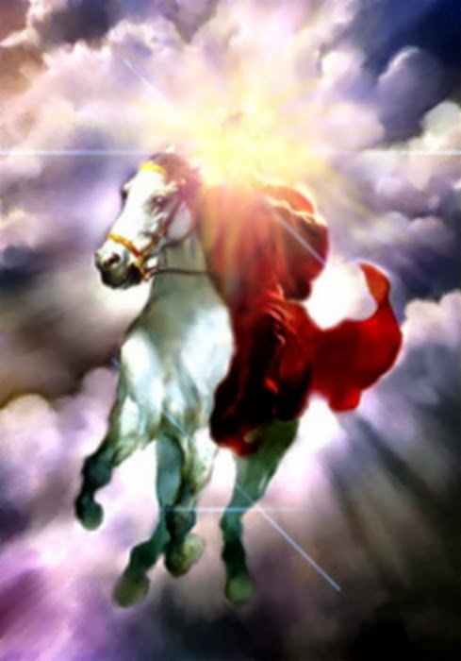
“eyewitness of His Majesty”
Notes:
Peter says, “No we did not cleverly make up stories of His Coming, but we were “eyewitness of His Majesty”. His account came to him from heaven when he heard the voice of God on the mountain. He did not make up the story in his own mind, but the story originated in the mind of God. Just as the story of His Coming in power and glory did not originate in the minds of the prophets of old who spoke the Word of the Lord guided and carried along by the Holy Spirit of God.
Peter in his second letter to the churches is reminding them of what the holy prophets and the apostles had early told them that ‘’scoffers will come in the last days” saying, “Where is the promise of His coming?” “No!” they say, “He’s not coming to rule and reign on the earth.”

Slide 4
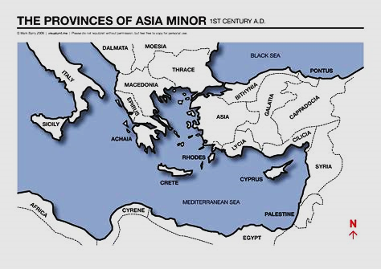
“to the pilgrims of the dispersion in Pontus, Galatia, Cappadocia, Asia, and Bithynia…” (1:1b)
Notes:
The recipients of this second letter was the same as those in his first letter. They were temporary residents of those Jews who were dispersed or scattered amongst the Roman providences of Pontus, northern Galatia, Cappadocia, northern Asia (Asia Minor) and Bithynia (1 Peter 1:1b)

Slide 5
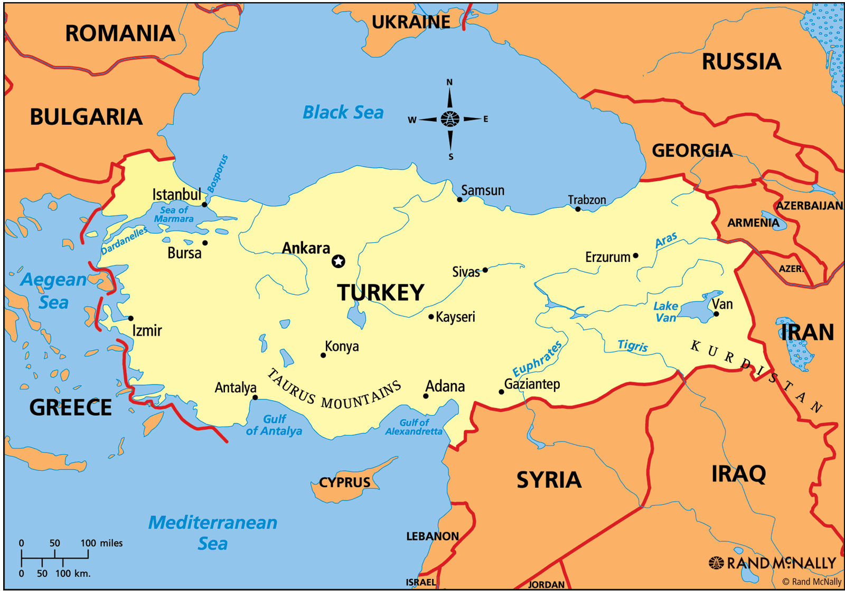
Notes:
Modern Turkey

Slide 6
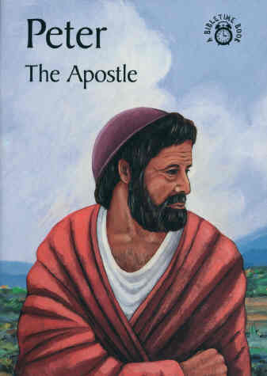
FIRST AND SECOND PETER
Author
“Peter, an apostle of Jesus Christ…” ( 1 Peter 1:1a)
“Simon Peter, a bondservant and apostle of Jesus Christ (2 Peter 1:1)

Slide 7
FIRST AND SECOND PETER
Dates
First Peter – 64 AD
Second Peter – 68 AD
Jude – 80’s AD
Notes:
Jude, the brother of James, who were the half brother of Jesus mostly likely wrote the letter of Jude sometime in the 80’s. Jude is a parallel to 2 Peter chapter 2. The reasoning behind this is that Peter says that many false teachers are coming (future tense) Jude says that many false teachers have come (past tense).

Slide 8
FIRST AND SECOND PETER
Historical Background
First Persecution of Christians by Nero – 64 AD
First Jewish-Roman War
66-73 AD
Notes:
Nero was the last Roman emperor of the Julio-Claudian Dynasty [Augustus, Tiberius, Caligula, Claudius]. He was adopted by his great uncle Claudius and became his heir and successor. He reigned for 14 years. Nero died from assisted suicide on June 9, 68 AD. Turmoil reigned in the year of 4 emperors – Vespasian prevailed, reigned from 69-79, followed by his sons Titus (79-81) and then Domitian (81- 96 AD).
Persecution of Christians by Rome – There was no empire-wide persecution of Christians until the reign of Decius in the 3rd century. Persecution of Christians began with Nero, but seemed to be isolated mostly in the Rome itself. It is reported that Nero blamed the Christians for the great fire of Rome in July 64 AD, though it is believed that He order the fire to be set for His own amusement. As many Christians that could be found were subjected to the most horrific deaths—wrapping and sewed them with skins of wild animals and then eaten by dogs; others were soaked in wax or pitch and set on fire to light the gardens at night. In the course of time both Paul and Peter were executed just before or after Nero death in the summer of 68 AD.
The war began over a dispute over taxes. Jewish rebels (freedom fighters) overran a Roman garrison and killed 6000 soldiers. Nero ordered Vespasian to crush the rebellion. Vespasian invaded Galilee in AD 67 and many rebels fled to Jerusalem. There was a lull in military operations when Vespasian had to return to Rome to deal with the turmoil there as a result of Nero’s death. His son Titus was left to complete the besieging of Jerusalem and breached the walls and destroyed the city and the temple in 70 AD.

Slide 9
FIRST AND SECOND PETER
Historical Background
Peter and Paul were departing soon – 68-69 AD
He was Leaving them a Reminder
The Gospel of Mark
Notes:
Peter knew that His time was almost up, he was going to “put off his tent”, because he was now old and the Lord had told Him he would be lead away to a place he did not want to go, that is he would be crucified, when he was old. Not only was he leaving two letters as a reminder of the things he had taught them but was already preparing a Gospel account that Mark would completed. He was also aware of the many letters that the Apostle Paul was leaving to the churches as well.

Slide 10
Salvation of the Soul
The Salvation of the soul is the total transforming work of God upon our lives, which is presently being realized in the midst of Christ like suffering, and which in the future will be unveiled in Christ like glory.

Slide 11
Growing in Holiness
in Light of the Promised Blessed Hope of the Lord and Savior’s Soon Return
Notes:
The theme of Second Peter is…

Slide 12
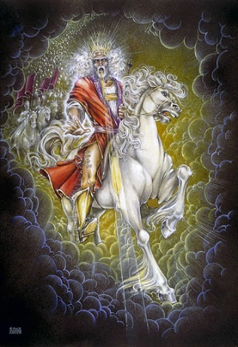
Growing in Holiness
2 PETER
The Blessed Hope is the certainty that our God and Savior Jesus Christ is retuning soon, just as He promised to rescue us before the Day of the Lord, and at the very end, the world is going to burn. In light of this Peter tells us how we should then live.
Notes:
In 3:10-13, Peter says, “But the day of the Lord will come as a thief in the night, in which the heavens will pass away with a great noise, and the elements will melt with fervent heat; both the earth and the works that are in it will be burned up. Therefore, since all these things will be dissolved, what manner of persons ought you to be in holy conduct and godliness, looking for and hastening the coming of the day of God, because of which the heavens will be dissolved, being on fire, and the elements will melt with fervent heat? Nevertheless we, according to His promise, look for new heavens and a new earth in which righteousness dwells.”
The Blessed Hope is the certainty that our God and Savior Jesus Christ is retuning soon. At the end of all things the present created world and heaven is going to dissolve away in a great ball of fire and with a mighty roar. This is no fairy tale, no obscure passage of Scripture whose detains we can ignore. In fact His coming with power and glory is based on eyewitness testimony of what he and his fellow Apostle both saw and heard. And it is confirmed by God the Father and the Holy Spirit of God.

Slide 13
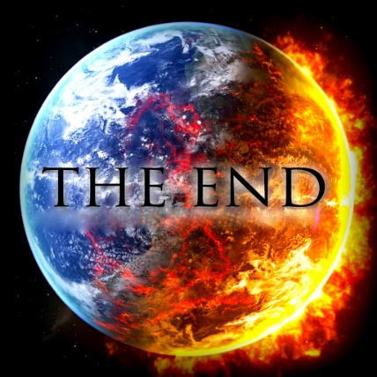
Growing in Holiness
2 PETER
Key Verse:
“Therefore, since all these things will be dissolved, what manner of persons ought you to be in holy conduct and godliness” (2 Peter 3:11)
Notes:
“Therefore, since—it is certain that--all these things (the heaven, the elements, the earth and the works that are in it) will be dissolved (loosen), what manner of persons ought you to be in holy conduct and godliness” (2 Peter 3:11)

Slide 14
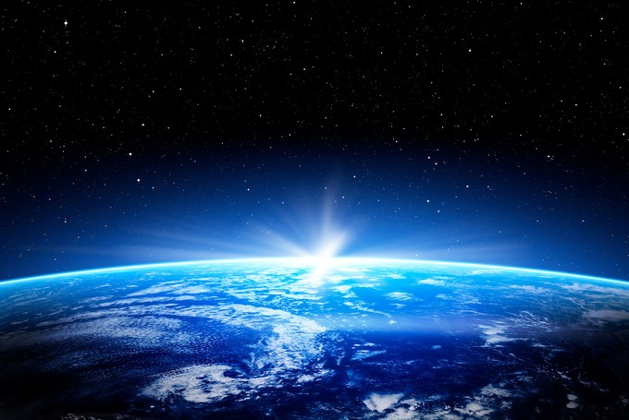
Growing in Holiness
2 PETER
A Verse of Hope:
“Nevertheless we, according to His promise, look for new heavens and a new earth in which righteousness dwell” (2 Peter 3:13)
Notes:
In the beginning God created the heaven and the earth, when He finished God said it was very good! Only righteousness dwelled there at first. But due to the fall of man unrighteous began its ugly reign, and exists to this day. But at the end of all things God is going to create a new beginning. A time in which only righteous will dwell. A space in which only righteousness will exist. And an earth in which only righteous will endure.
We do not have to fear the apocalypse, “the end of this world”. There is no need to fear what the future holds. God is coming down to us and make all things new. Peter has already seen the future. He has already seen the Coming of the Lord. Peter does not preach a pessimistic message of doom and gloom, but teaches a lesson of light appearing out of darkness, from doom to bloom.

Slide 15
2 Peter 1:16-21
Notes:
“For we did not follow cunningly devised fables when we made known to you the power and coming of our Lord Jesus Christ, but were eyewitnesses of His majesty. For He received from God the Father honor and glory when such a voice came to Him from the Excellent Glory: "This is My beloved Son, in whom I am well pleased." And we heard this voice which came from heaven when we were with Him on the holy mountain.
And so we have the prophetic word confirmed, which you do well to heed as a light that shines in a dark place, until the day dawns and the morning star rises in your hearts; knowing this first, that no prophecy of Scripture is of any private interpretation, for prophecy never came by the will of man, but holy men of God spoke as they were moved by the Holy Spirit.”

Slide 16
Growing in Holiness
2 PETER
The Prologue of the Letter – 1:3-11
The Basis of Holiness – 1:3-4
Notes:
We have seen and heard already that Peter is concerned about the moral character of his flock and the dangers that threaten them. He first reminds them of the basis of their holiness, the gracious provision of power and promises that God has provided for their growth in holiness (vs. 3-4) which are the foundational reasons and the fundamental motivation of why we should follow through and add to our faith.

Slide 17
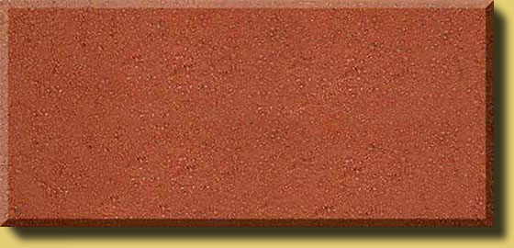
Growing in Holiness
2 PETER
The Prologue of the Letter – 1:3-11
The Basis of Holiness – 1:3-4
PARTAKE
POWER
PROMISE
KNOWLEDGE BASED FATIH
GOD’S GLORY AND VIRTUE
Notes:
He first reminds us of the basis of our holiness. It begins with God’s Person, His glory, His moral excellence, holiness and His love for us, that makes everything possible. It is the deepest foundation in whom we trust.
God’s is love, it is the reason that He loved the world and sent His Son as the provision for our salvation. Our faith is based in the knowledge of Christ’s person, His provision and His proclamation. It is by the means of our faith in Christ’s person and His provision that was proclaimed to us, that we received eternal life. It is by faith alone in Christ’s person and provision that we are saved, and have passed from death unto life.
Our faith in Christ is also the means by which we are now made recipients of a spiritual equipping and empowering in order to live for Christ. It is knowledge based faith in Christ that is also the means by which we can now access God’s power and promises.
It is God’s divine power that has sufficiently gifted each of us with all things related to life and godliness. We all have all that we could possible need to live a godly life and serve him faithfully. Nothing else is needed.
God has also given us “exceedingly great and precious promises.” God has given us the promise of eternal life, for all who simply believe in Christ. In this second letter Peter has most on his mind the promises that God has given us in order that we live godly in this life. And these promises, along with his power, are the means by which we have access to become partakers of God’s very nature, to become Christ like. We cannot and do not become God Himself, like the Mormons teach. But we can become like God in moral His character.

Slide 18
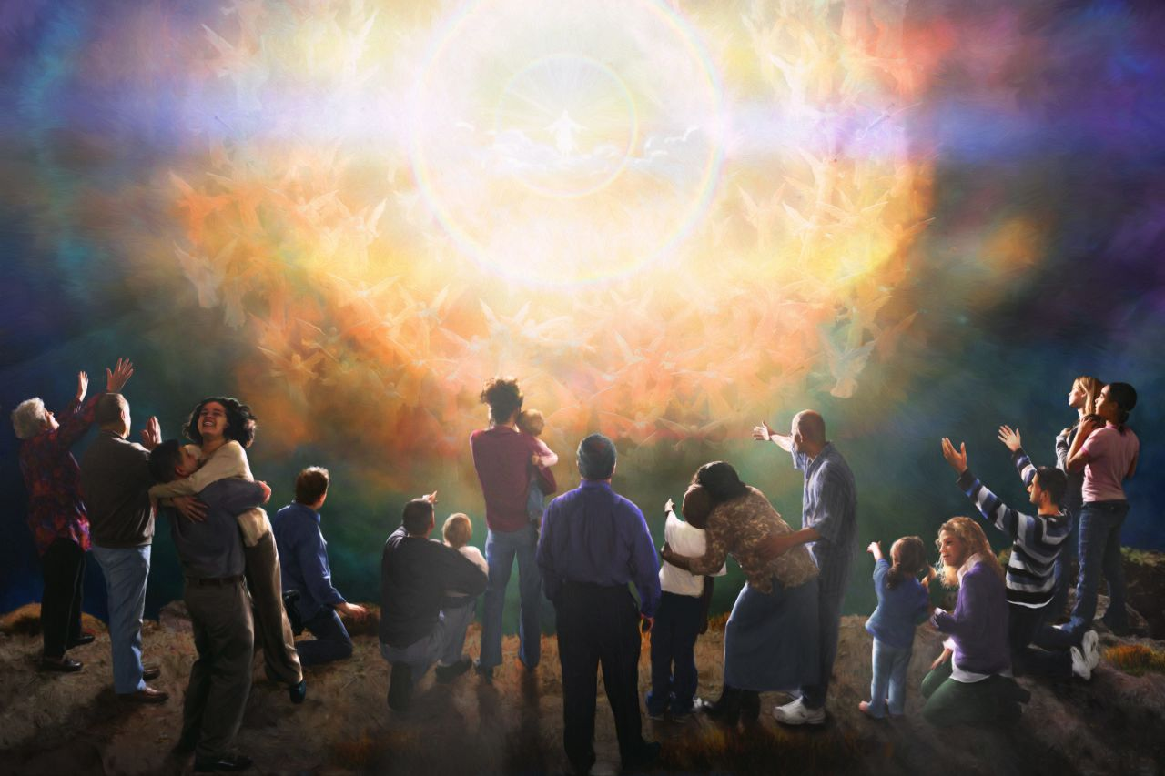
Growing in Holiness
2 PETER
The Promised Return
Notes:
Peter also has in mind the future prophetic promise of the coming of the Lord Jesus Christ. This promise includes His physical bodily return to establish the kingdom of God on earth, to regather and restore the nation of Israel to their promise land, after He has destroy their enemies, which are also His enemies.
Peter, along with his fellow disciples, James and John, have already seen a vision of His Coming. But when Jesus comes at the end of the age, at that time every eye on earth will see Him. This is the “apocalypse”--the revelation, the unveiling of the Lord Jesus Christ which will bring an end to the age, the Mosaic age. The Mosaic age did not end in AD 70. One more week of seven years is necessary to bring that age to its conclusion. Afterwards, Christ will begin his reign on earth for 1000 years.
After the 1000 years this will bring an end to all things, when Christ has brought all things in subjection to Him. At that time God will fulfill the promise of a new heaven and earth in which only righteousness dwells, where there will no sin. God will “wipe away every tear from our eyes; there shall be no more death, nor sorrow, nor crying. There shall be no more pain, for the former things have passed.” (Rev. 21:4) We now live in anticipation of all these things.
In order for us to maintain a holy life in a corrupt world like ours, we must be deeply fixed in these prophetic promises of God’s word. We must hold fast/stand in the “blessed hope” of the return of our Lord and Savior Jesus Christ. Failing to do so only leads to fear and to an absence of readiness. The absence of readiness then leads to a loss of future rewards, praise, honor, and glory.
He first reminds them of the basis of their holiness, which are the foundational reason why we should follow through and add to our faith. Next…
.

Slide 19
Growing in Holiness
2 PETER
The Promised Return
Notes:
In order for us to maintain a holy life in a corrupt world like ours, we must be deeply rooted in these prophetic promises of God’s word. We must hold fast/stand in the “blessed hope” of the return of our Lord and Savior Jesus Christ. Failing to do so only leads to fear and to an absence of readiness. The absence of readiness then leads to a loss of future rewards, praise, honor, and glory.
In order for us to maintain a holy life in a corrupt world we must know what holiness looks like.

Slide 20
Growing in Holiness
2 PETER
LOVE
The Basics of Holiness – 1:5-11
The Characteristics
of Holiness – 1:5-7
BRO. KINDNESS
GODLINESS
PERSEVERANCE
The Consequences
of Holiness – 1:8-9
SELF CONTROL
KNOWLEDGE
The Conclusiveness of Holiness – 1:10-11
VIRTUE
FAITH
Notes:
Peter describes the basics of holiness, beginning with the basic characteristics of holiness…
Afterwards, Peter describes the basic consequences of holiness in verses 8-9. He first states the case positively, that if these qualities are diligently pursued it will produce an active, fruitful Christian. Then he states the case negatively that those who fail to diligently pursue these attributes leads to a blind and shortsighted life which God’s past grace is seemly forgotten. Producing an active, fruitful life now is the good reason that moral development is to motivate diligence in spiritual growth.
Lastly, Peter describes the basic inevitable results of holiness (10-11), which is the other good reason these traits should motivate us to increased diligence. These results are of a broader scope. For these results include a verification of our calling and choice for service, and a rich welcoming into the coming kingdom of God. This will be our proof and praise that we have in fact diligently sought His holiness.

Slide 21
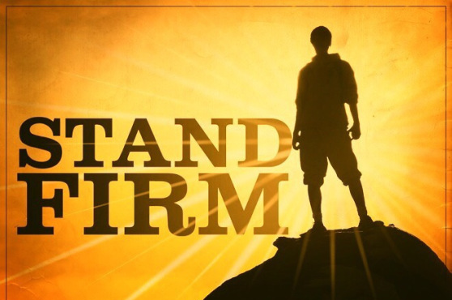
Growing in Holiness
2 PETER
The Purpose of the Letter – 1:12-15
To Establish Them in the Present Truth
Notes:
After the introduction, (3-11), the Peter discloses his purpose in writing this second letter in verses 12-15. His purpose is that his readers stand firm and to establish them in the present truth.
That truth includes the certainty of Christ return--the promise of His Coming. This promise, is, has and will, come under attack from “scoffers” (3:3-4) who deny Christ physical return. The remainder of the epistle is basically a defense of the godly lifestyle to which the great promise concerning the end of all things motivates us (3:11-13). The “scoffers” in turn are condemned for their unbelief and skepticism. The “scoffers” are also condemned for their immoral lifestyle, which is a direct result of their denial of Christ’s coming in judgment.
In this brief section of the letter (1:12-15) Peter reinforces the immediate truth his readers already possess and encourages them to stand firm and not be moved from their present position, but the danger always exists that they could fall into error.

Slide 22
Growing in Holiness
2 PETER
The Body of the Letter – 1:16 – 3:13
Hold Fast to the Hope of Christ’s Coming
Notes:
Now we come to the main body of the letter in which Peter is going to strongly encourage his readers to hold fast to the hope of Christ’s coming.

Slide 23
Growing in Holiness
2 PETER
The Body of the Letter – 1:16 – 3:13
The Hope of Christ’s Coming…
is a Certainty – 1:16-21
will Encounter Opposition – 2:1 - 3:9
will Culminate in the Day of the Lord – 3:10-13
Notes:
They need to hold fast because His coming is first of all a certainty. Secondly they need to hold fast in spite of opposition and last because the Day is coming, the Day of the Lord that is, which could be any day now.

Slide 24
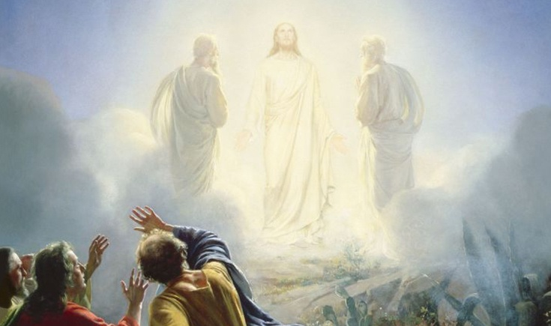
Growing in Holiness
2 PETER
The Body of the Letter – 1:16 – 3:13
The Hope of Christ’s Coming…
is a Certainty [Based on] – 1:16-21
Reliable Eyewitness Testimony – 1:16-18
Notes:
There were outsides who sneaked into the church and became insiders saying that the stories of the Coming of the Lord Jesus Christ in power and glory is a mere “cunningly devised fables”. The doctrine of the Second Coming was merely a shrewdly designed “myth”. Fables and myths are fairy tales, make believe stuff.
Peter says, “Not, so!” He provides proof that he and his fellow apostles (James and John) were eyewitnesses of Christ’s future “majesty” when—at the transfiguration—they were allowed to see and behold in a vision the Son of Man coming in His Kingdom—the Kingdom of God present with power—or simply the kingdom of God!” They saw in the present, the future Coming of the mighty King--the mighty splendor of the King of Glory.
In addition to what they saw of His coming power and majesty they heard the very voice of God the Father concerning His Son, the Lord Jesus Christ giving Him honor and glory.
The voice of God is brought to Jesus by “the Excellent Glory”. The Excellent Glory refers to the “bright cloud” that “overshadowed” Jesus and His disciples, out of which the came the divine voice (Mt. 17:5). This would be the same cloud as the Shekinah glory which in OT times, represented the glorious presence of God. This cloud became visible at the inauguration of the Tabernacle and at the dedication of Solomon’s temple (Exod. 40:34-35; I Kings 8:10-11) and will return once again to fill the millennial temple.
The voice did not simply come from heaven, but God the father personally came down from heaven in His glorious cloud and spoke regarding His Son. This adds to the greatness of the tribute which God’s gives to His Son. “This is My beloved Son, in whom I am well pleased”.
The words are spoken as a reminder the Jesus is worthy to reign precisely because He did all that God desired and required Him to do. The Lord obtained His throne because He pleased His Father so well. The throne, the right to rule, was the joy that enabled Jesus to endure the cross, despising the shame, that made it then possible for Him to sit down at the right hand of the throne of God. (Heb. 12:2).
The clear implication is for us should be to seek to be well-pleasing to God as well, diligently pursuing to add godly character to our faith, so that when Jesus comes into His Kingdom, we may also share in His kingly rule, for those who endure with Him will also reign with Him.

Slide 25
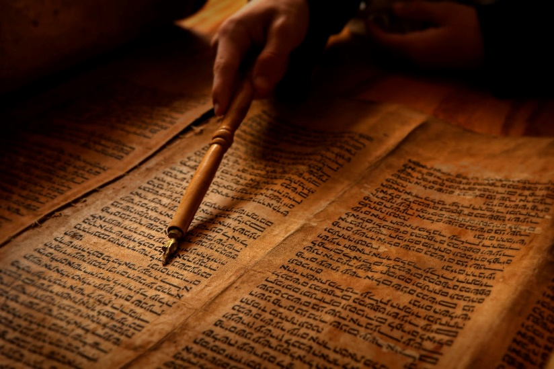
Growing in Holiness
2 PETER
The Body of the Letter – 1:16 – 3:13
The Hope of Christ’s Coming…
is a Certainty [Based on] – 1:16-21
The Prophetic Word – 1:19-21

Slide 26
Growing in Holiness
2 PETER
The Prophetic Word
“And so we have the prophetic word confirmed, which you do well to heed as a light that shines in a dark place, until the day dawns and the morning star rises in your hearts;” (1:19)
Hold Fast the Hope of Christ’s Coming
Notes:
“And so we have the prophetic word confirmed…” The “prophetic word” was the “Scriptures” [Writings] which had predicted the Coming of the Lord in power and glory—this vision of His Coming in power in the transfiguration of Christ confirmed those Scripture. This private manifestation of His majesty to three His disciples was an unmistakable confirmation of its future public manifestation to the whole world, in which every eye will see Him, when the Lord Jesus returns in power and great glory.
If you have an old KJV, you will notice the rendering “more sure”, in the NASB, “made more sure”, or in the NIV “made more certain” – “we have a prophetic word made more sure” [NASB]. The point is not that the prophetic word is “more sure” or greater than the of the divine manifestation of His coming in power at the transfiguration, but that the spoken prophetic word of God becomes greater or verified by the event the disciples experienced.
The prophets of old spoke a prophetic word from God concerning the coming of the Lord. The fact that the prophets spoke from God Himself [who cannot lie] made the prophetic word an absolute certainty which nothing could be added or subtracted. However, Peter’s vision of the coming of the Lord in power and glory makes the spoken prophetic Word already certain, even more certain. Peter saw and experienced a vision of the actual event which then verified the truth of the prophetic word spoken earlier by the prophets. Just as Peter and the other Apostles served in the vital role as eyewitnesses of Jesus resurrection (Acts 10:41), so also Peter’s eyewitness account serves a vital role in regards to His future coming.
Peter has made great pains to recount the events of the Transfiguration which confirms the prophetic Word of the Lord’s Coming because of the “scoffer” (3:3-4) who have come and are coming in greater numbers to ridicule this very promise of His coming. They reject the truth that the Lord Jesus Christ is ever returning, coming again. They reject the truth that He is coming to establish His kingdom of earth, which is exactly what believers are called to diligently seek to abundantly enter. Many reject His Coming just as they also reject the eyewitness testimony and prophetic word of God concerning the Lord’s death and resurrection. Other “scoffers” reject a future return of Christ and say that the Lord has already come and His kingdom is already here in power and all its glory, fulfilled “allegorically” or “spiritually” in the Church.
But to deny the future Second Coming of the Lord in power and glory was and is to annul for believers the powerful motivation to holiness which this expectation provides (1:5-11). It is to deny one of the “exceedingly great and precious promises” the means by which the believer could experientially participate, “become partners” in “the divine [holy] nature” and escape “the lustful corruption that is in the world”. In the next couple of chapters we will see that in fact the “scoffers” corruption through worldly lust is a direct result of their denial of the Lord’s return in judgment.

Slide 27
Growing in Holiness
2 PETER
The Prophetic Word
“And so we have the prophetic word confirmed, which you do well to heed as a light that shines in a dark place, until the day dawns and the morning star rises in your hearts;” (1:19)
Hold Fast the Hope of Christ’s Coming
Notes:
Now, since the prophetic Word of His coming spoken by God through holy men directed by the Holy Spirit has been confirmed and verified by Peter’s vision, the readers response ought to be to heeded, “prosecho” (pros-ekh'-o); to hold in your the mind; that is, “to give careful attention”, applying oneself to and adhering to this truth. It is good thing to have this truth echoing about in your head, because the truth of His Coming is “as a light shines in a dark place”. You want something to do? Then do this.
What we have here is a “metaphor”. A metaphor of what the literal future coming of Christ to the earth is liken too. The metaphor is tip off by the English word “as” [or “like” – the kingdom of God is “like”], it from the Greek word “hos” meaning “in this manner”. The coming of the Lord will be like a light that shines in a dark place. The dark place is obviously the world in which we live, where the only hope for change lies in the Second Coming of Christ, a light out of darkness, from doom to bloom.
The word rendered “dark” is an uncommon word meaning more like a “dismal, gloomy, and depressing” place. The world can be a dismal place characterized by ignorance, corruption and death. The light is more like a lamp. Thus the prophetic word is like a lamp that illuminates God’s prophetic truth of the Second Coming though the world is a dark and dismal place.

Slide 28
Growing in Holiness
2 PETER
The Prophetic Word
Hold Fast the Hope of Christ’s Coming
Notes:
The certain truth of His Coming will not only light the dark world, but can give light and hope to our minds in advance of His Coming. The reality of His Coming can become so real to our minds that it could be said that the day has already “dawned” in our hearts as though Christ Himself, the bright and morning star (Rev. 22:16) has already shown brightly in the dark world.
The bright and morning star in the heavens is the planet Venus which is the brightest star in the sky which appears on the horizon at certain times of the year just before or at the same time as the dawns early light. It also is known as the evening star that appears in the west just as the sun is setting.

Slide 29
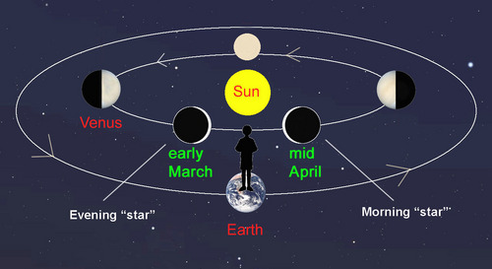
Growing in Holiness
2 PETER
The Prophetic Word
Hold Fast the Hope of Christ’s Coming

Slide 30
Growing in Holiness
2 PETER
The Prophetic Word
“Now when Jesus heard that John had been put in prison, He departed to Galilee. And leaving Nazareth, He came and dwelt in Capernaum, which is by the sea, in the regions of Zebulun and Naphtali, that it might be fulfilled which was spoken by Isaiah the prophet, saying…”
Notes:
When Jesus first came the light began to shine out of darkness. We read in Matthew 4:12-16, “Now when Jesus heard that John had been put in prison, He departed to Galilee. And leaving Nazareth, He came and dwelt in Capernaum, which is by the sea, in the regions of Zebulun and Naphtali, that it might be fulfilled which was spoken by Isaiah the prophet, saying: ‘The land of Zebulun and the land of Naphtali, by the way of the sea, beyond the Jordan, Galilee of the Gentiles: The people who sat in darkness have seen a great light, and upon those who sat in the region and shadow of death light has dawned.“

Slide 31
Growing in Holiness
2 PETER
The Prophetic Word
“The land of Zebulun and the land of Naphtali, by the way of the sea, beyond the Jordan, Galilee of the Gentiles: The people who sat in darkness have seen a great light, And upon those who sat in the region and shadow of death light has dawned.” (Matthew 4:12-16)
Notes:
When Jesus first came the light began to shine out of darkness. We read in Matthew 4:12-16, “Now when Jesus heard that John had been put in prison, He departed to Galilee. And leaving Nazareth, He came and dwelt in Capernaum, which is by the sea, in the regions of Zebulun and Naphtali, that it might be fulfilled which was spoken by Isaiah the prophet, saying: ‘The land of Zebulun and the land of Naphtali, by the way of the sea, beyond the Jordan, Galilee of the Gentiles: The people who sat in darkness have seen a great light, and upon those who sat in the region and shadow of death light has dawned.“

Slide 32
Growing in Holiness
2 PETER
The Prophetic Word
Hold Fast the Hope of Christ’s Coming
Notes:
So, the bright and morning star has appeared once already, we are now waiting in anticipation of its appearing once again. In the mean time the certainty of its appearing brightens our hearts.

Slide 33
Growing in Holiness
2 PETER
The Prophetic Word
“knowing this first, that no prophecy of Scripture is of any private interpretation, for prophecy never came by the will of man, but holy men of God spoke as they were moved by the Holy Spirit.” (1:20-21)
Hold Fast the Hope of Christ’s Coming
Notes:
There is also something else we need to know and that is, “no prophecy of Scripture is of its own interpretation” – “No passage of Scripture has its own, peculiar interpretation so that it can be treated in isolation from other prophetic passages”.
The reason is that any individual prophetic words [especially regarding the coming of the Lord] is not of its own interpretation [or cannot be explained independently] is that prophecy did not come from the will or the mind of man—it did not originate with any man, but was the product [origination] of the Holy Spirit who spoke through holy [set apart] men of God—men who spoke on behalf of God—called the prophets. “Thus one Author stands behind every Scripture prophecy, [concerning the coming of the Lord] the Spirit of God. The result is a series of interconnected, harmonious utterances which cannot be correctly understood independently from one another.” [Hodges, p. 51]
These verses are very likely aimed at the “scoffers”. They were blowing their whistle, no doubt calling Peter’s stories and the prophets stories of the coming of the Lord “cunningly devised fables”. In the process, they were apparently also claiming that many of the OT prophesies did not really refer to a future return of Christ in power and glory at all, but simply to individual and isolated events in OT times, in many cases already fulfilled.
The scoffers were corrupt and they who were the ones who made up stories and fables. In contrast the prophets of old were not corrupt, but were holy men of God who did not just conjured up stories in their own minds.

Slide 34
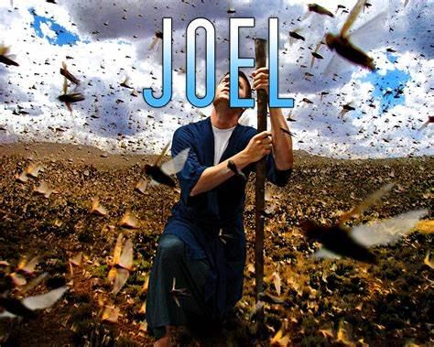
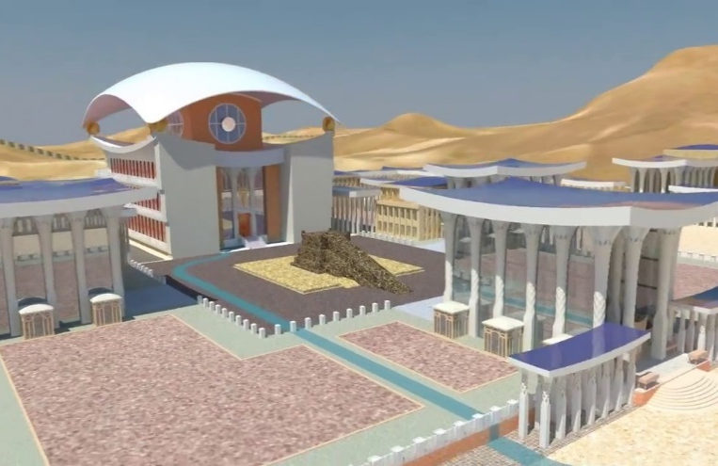
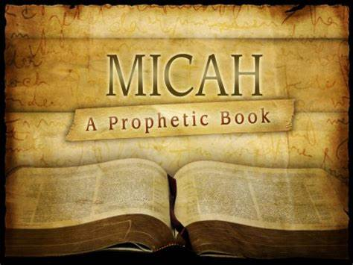
Growing in Holiness
2 PETER
Daniel
Ezekiel
Hold Fast the Hope of Christ’s Coming
Notes:
According to the scoffers, each of the OT prophesy concerning the coming of the Lord had their own particular explanation, being understood as isolated utterances of men speaking to their own particular historical life situation. By interpreting the OT Scriptures in this manner they were denying the single authorship of these prophesies by the Holy Spirit Himself. Peter is saying that the truth about the return of Jesus Christ to earth to reign is not a hodgepodge of cleverly concocted myths, put together by means of misconceptions of OT prophesies which Peter and the other apostles had wrongly pasted these prophesies together into a single coherent picture of the future.
The scoffers were corrupt and they who were the ones who made up stories and fables. In contrast the prophets of old were not corrupt, but were holy men of God who did not just conjured up stories in their own minds.

Slide 35
Growing in Holiness
2 PETER
The Prophetic Word
“knowing this first, that no prophecy of Scripture is of any private interpretation, for prophecy never came by the will of man, but holy men of God spoke as they were moved by the Holy Spirit. ” (1:20-21)
Hold Fast the Hope of Christ’s Coming
Notes:
“prophecy never came by the will of man” – that is “God given prophecy was the product of the Holy Spirit”, they were not merely writing their own ideas, in contrast to the false prophets who Ezekiel said “prophesied out of their own heart”. He says, the foolish prophets, follow their own spirit and have seen nothing!” (Ezek.13:2-3)
Though the false prophets claimed they spoke from God, Jeremiah says they lied about the Lord and His word is not in them, they are mere wind (Jer. 5:12-13) The Lord said to Jeremiah, "The prophets prophesy lies in My name. I have not sent them, commanded them, nor spoken to them; they prophesy to you a false vision, divination, a worthless thing, and the deceit of their heart. (Jer. 14:14) The false prophets were corrupt “given to covetousness” (6:13) liars and deceivers, and reckless (23:32), who stole words from the Lord (23:30).
God given prophecy was given through holy men of God, men who were without deceit. God did not speak through corrupt individuals and deceivers, but men set apart to God, who spoke only what they were told to say.
The “holy men of God spoke as they were moved (pheromenoi) by the Holy Spirit”. The Greek word “moved” is a form of the same verb that Peter used to describe the voice he heard back in verses 17 and 18, when “a voice came to Him from the Excellent Glory” “…And we heard this voice which came from heaven…” So, the words they spoke came from the Holy Spirit. They were divinely inspired, “God breathed” communication. In fact Paul says, “all Scripture is given/came by the inspiration of God” (2 Tim. 3:16).

Slide 36
Growing in Holiness
2 PETER
The Prophetic Word
“Now we have received, not the spirit of the world, but the Spirit who is from God, so that we may know the things freely given to us by God, which things we also speak, not in words taught by human wisdom, but in those taught by the Spirit, combining spiritual thoughts with spiritual words.” (1 Cor. 2:12-13) [NASB]
Notes:
Paul elaborates on the process of inspiration in 1 Cor. 2:12-13 when he say, “Now we have received, (and give to you) not the spirit of the world, but the Spirit who is from God, so that we may know the things freely given to us by God, which things we also speak, not in words taught by human wisdom, but in those taught by the Spirit, combining spiritual thoughts with spiritual words.” [NASB] Not only are the words they spoke from the Spirit, but the very thoughts themselves came from the Spirit of God.

Slide 37
Growing in Holiness
2 PETER
Conclusion
Hold Fast the Hope of Christ’s Coming
Notes:
Peter is telling us to Hold Fast the Hope of Christ’s Coming—it is a certainty based on reliable eyewitness testimony and based on reliable prophetic prophecy. Don’t fall for fake whistle blowers, these pseudo teachers with their corrupt message and corrupt lifestyle.
Peter is blowing his own whistle, warning the church in advance. The false teachers are coming! The false teachers are coming! Opposition to the message of the hope of Christ coming is here and with it the danger of falling victim to their corruption. If we are to overcome the corruption of this world and the false teachers and grow in holiness we must stand firm in the hope of Christ’s coming! When we stand firm in a deep confidence in the reality of direct, inspired prophecy of God, we gain full-hearted confidence in the expectation of the Savior’s soon return.

